Slide 1
HTML5 SEMANTIC ELEMENTS
A semantic element clearly describes its meaning to both the browser and the developer.
<img> , <form> , <table> i.e. these elements define its contents clearly.
Non-semantic elements generally tells nothing much about its content.
Traditionally developers have implemented non-semantic elements with a class attribute to define the structure and express the meaning of content.
Examples of non-semantics elements are : <div> and <span> i.e. these elements tells nothing about its content.

Slide 2
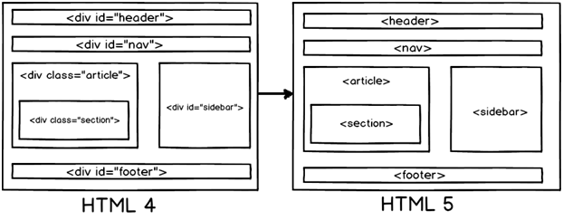
HTML4 AND HTML5 COMPARISON

Slide 3
Why Semantic Elements?
HTML5 semantic elements help structure the code we
create, and therefore making it more readable and easier to maintain.

Slide 4
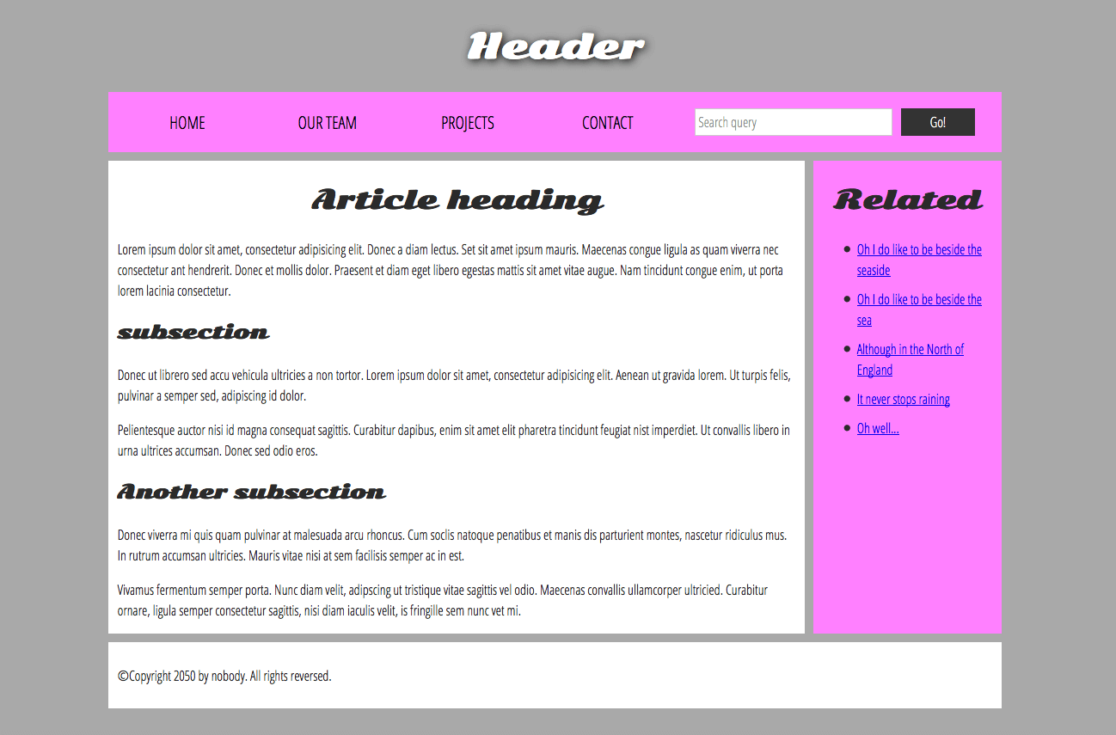

Slide 5
The Separation of Style, Content and Behavior
Core Concept of web development
HTML + CSS + JavaScript
Content + Style + Behavior
CSS is a rule-based language — you define rules specifying groups of styles that should be applied to particular elements or groups of elements on your web page.
Notes:
This is the core concept of not just CSS, but web development in general. In a lot of ways it’s taken for granted now, but it wasn’t always so.

Slide 6
Our New HTML
<h1>Fancy Lads</h1>
<p>Welcome to The Fancy lad Site!</p>
<p>This web-page is the semi-official home of Fancy lads on the World Wide Web.</p>
<!--How much simpler is that?→
<p align="center">
<font face="Papyrus"><img border="0" src=“fancy-header.png” width="207" height="279"></font>
</p>
<p align="center">
<font face="Papyrus“> Welcome to The Fancy lad Site!</font>
</p>
<p align="center">
<font face="Papyrus">This web-page is the semi-official home of Fancylads on the World Wide Web.</font>
</p>
Notes:
And this is a simpler example to start with. With the real tag soup pages you could cut out probably 70% of the markup. Don’t worry if none of this makes perfect sense yet. It’s there just to illustrate how much markup CSS can save.

Slide 7
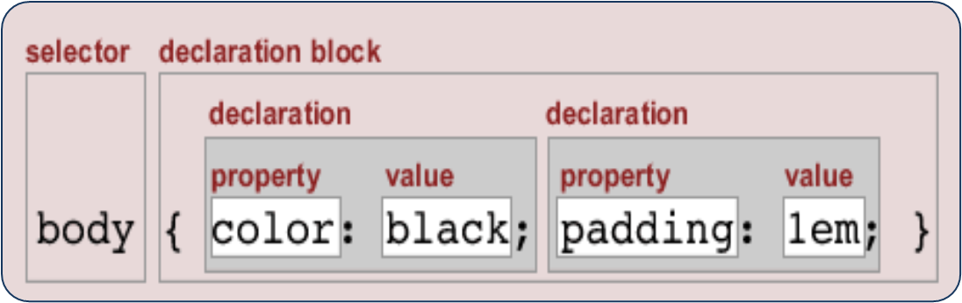
Let’s See the Associated Style Sheet
h1{
background:url(fancy-header.png) no-repeat;
width:207px;
height:279px;
text-indent:-9999px;
}
p {
text-align:center;
font-family:papyrus;
}
Notes:
And here’s where all that info goes.

Slide 8

Selector that directly matches an HTML element name.
Target multiple selectors at once, by separating the selectors with a comma.
p, li { color: green; }
Changing the default behavior of elements
li { list-style-type: none; }
To select a subset of the elements without changing the others.
.special { color: orange; font-weight: bold; }
li.special { color: orange; font-weight: bold; }

Slide 9
descendant combinator
li em { color: rebeccapurple; }
adjacent sibling combinator)
h1 + p { font-size: 200%; }
Styling things based on state
a:link { color: pink; } a:visited { color: green; }

Slide 10

article p span { ... }
selects any <span> that is inside a <p>, which is inside an <article>
h1 + ul + p { ... }
selects any <p> that comes directly after a <ul>, which comes directly after an <h1>
body h1 + p .special { color: yellow; background-color: black; padding: 5px; }

Slide 11
Exercise-1
Write CSS rules that apply styling to different HTML elements:
font-size
width
background-color
color
border

Slide 12
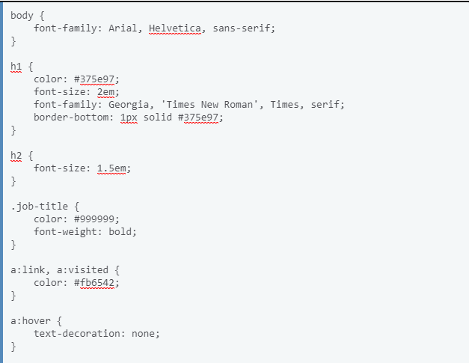
Exercise-2

Slide 13
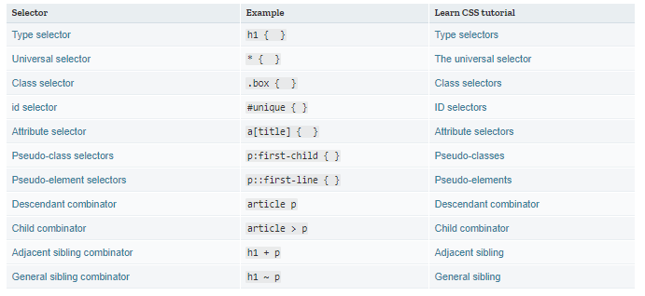
Selectors

Slide 14
cascade
Stylesheets cascade -order of CSS rules matter; when two rules apply that have equal specificity the one that comes last in the CSS is the one that will be used.
h1 { color: red; }
h1 { color: blue; }
<h1>This is my heading.</h1>

Slide 15
Specificity
Specificity is how the browser decides which rule applies if multiple rules have different selectors, but could still apply to the same element.
An element selector is less specific — it will select all elements of that type that appear on a page — so will get a lower score.
A class selector is more specific — it will select only the elements on a page that have a specific class attribute value — so will get a higher score.

Slide 16
Specificity
.main-heading {
color: red;
}
h1 {
color: blue;
}
<h1 class="main-heading">This is my heading.</h1>

Slide 17
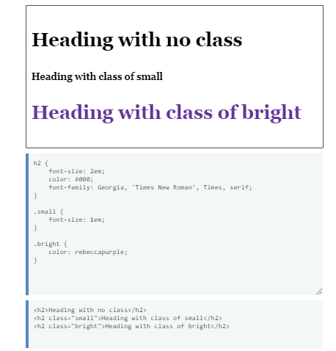

Slide 18
Inheritance
Some CSS styles are inherited and some not
  Text-related and list-related properties are inherited - color, font-size, font-family, line-height, text-align, list-style, etc
  Box-related and positioning styles are not inherited - width, height, border, margin, padding, position, float, etc
  <a> elements do not inherit color and text-decoration

Slide 19
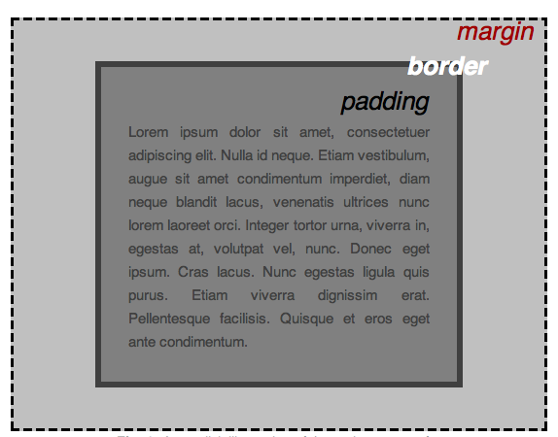
CSS box model
Content box: The area where your content is displayed, which can be sized using properties like width and height.
Padding box: The padding sits around the content as white space; its size can be controlled using padding and related properties.
Border box: The border box wraps the content and any padding. Its size and style can be controlled using border and related properties.
Margin box: The margin is the outermost layer, wrapping the content, padding and border as whitespace between this box and other elements. Its size can be controlled using margin and related properties.
.

Slide 20
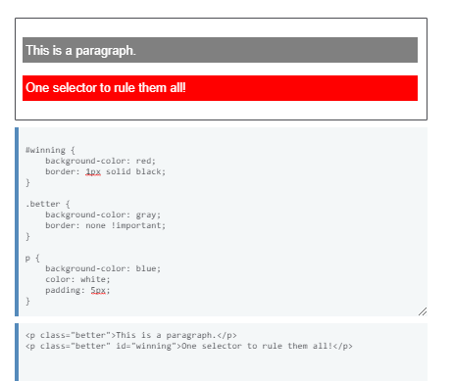
!important

Slide 21
Question No:1
Write a styling rule to assign background color to h1 element?

Slide 22
Question No:2
The top border = 10 pixels
The bottom border = 5 pixels
The left border = 20 pixels
The right border = 1pixel?

Slide 23
Question No:3
How do you group selectors to have same styling property?

Slide 24
Question No:4
How do you assign properties common to subset of html elements?

Slide 25
Question No:5
Identify the selector to leave space between the content and the border of an element?

Slide 26
Question No:6
Give the element with a class of alert a 1px grey border.
If the element with a class of alert also has a class of stop, make the background red.

Slide 27
Question No:7
Style links, making the link-state orange, visited links green, and remove the underline on hover.

